Slide 1

Rebuilding the Workforce:
The Opportunities and Risks of Artificial Intelligence
Stijn Broecke
Senior Economist (Future of Work)
OECD
Notes:
Who you are
About the OECD
This presentation:
How labour markets are changing, in particular as a result of technological change
What that means for skills needs
Home in on AI and its implications for the human resource and resource function

Slide 2
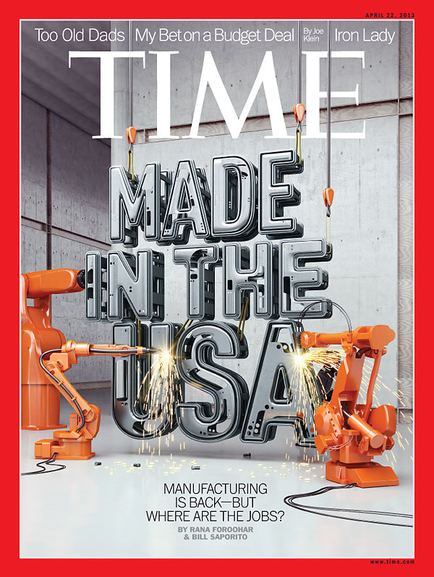
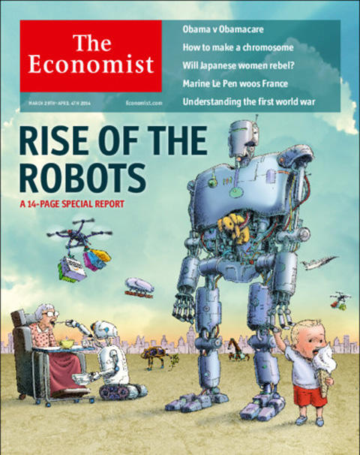
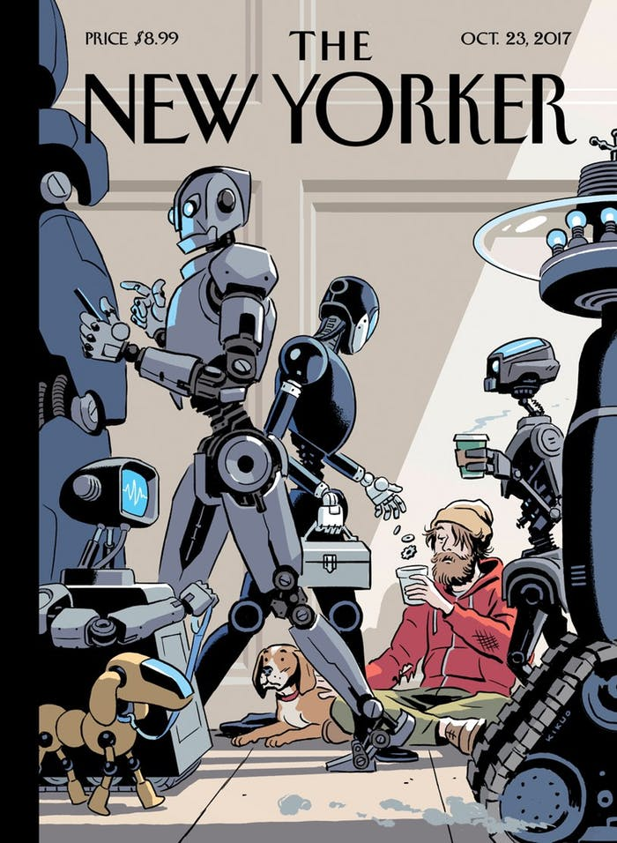
The end of employment?
2013
2014
2017
Notes:
Frey & Osborne (2017): 47%
Brynjolfsson & McAffee (2014): “There’s never been a worse time to be a worker with ordinary skills because computers, robots and other digital technologies are acquiring these skills and abilities at an extraordinary rate”

Slide 3
Employment is on the rise

Slide 4
The labour market is changing
Notes:
Long-term structural changes
Technological change
Globalisation
Ageing
UK:
22% increase in jobs for high-educated

Slide 5
The demand for skills is changing
Excess

Slide 6
Ageing will worsen skills needs
Notes:
Ratio of people aged 65 and over to the working age population
Less than .3 now to .4 in 15 years time to 46% by 2060
Ageing population – risks involved in many skills disappearing from the labour force => we need to extend working lives
The need for lifelong learning

Slide 7
So far, automation risk has affected primarily the low-educated
Notes:
Automation is a trend that, so far, has not really affected the higher education sector
The high-skilled: less than 6% chance of automation
The low-skilled: over 20% chance
=> So around 3 times more likely to see their job automated

Slide 8
The high-skilled will be more exposed to AI
WORK IN PROGRESS - PLEASE DO NOT CITE
Notes:
BUT AI will change this story a little
Business professionals
It technology prefessonals
Chief exectuvies
Sciencetists and engineers, etc.
Whereas those least exposed include cleaners, agricultural workers, food preparation assistants
This is because previous technologies targeted primarily routine. Middle-skilled tasks, whereas AI is capable of non-routine, cognitive tasks
Exposure – not necessarily a bad thing
Take a cardiologist

Slide 9
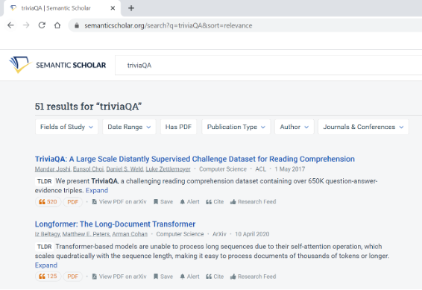
AI in the Higher Education Sector
Example: Semantic Scholar
Notes:
Semantic Scholar is an artificial-intelligence backed search engine for academic publications. It uses natural language processing to provide summaries for scholarly papers.
In November 2020, Semantic Scholar introduced the TL;DR (Too Long Didn’t Read) feature. This AI-powered tool condenses even complex computer science papers into a single-sentence summary, using natural language processing.
If you are a researcher, you may already be thinking about the time you could save by avoiding the gruelling task of mapping out evidence on a new topic. This new tool will finally allow you can shift your attention to the parts of your job that are more complex, analytical and social.
At the same time, you are probably a little concerned that it could replace you or one of your colleagues. The last time it took a team of four researchers to review the evidence. Will it only require three or fewer researchers in the future?

Slide 10
What is AI?
“A machine-based system that can, for a given set of human-defined objectives, make predictions, recommendations, or decisions influencing real or virtual environments”
Notes:
there is no really shared definition
AI encompasses a range of technologies
Specialists prefer to avoid the term “intelligence”, prefer to use the exact name of the technology used
Essentially machine learning
Thanks to computing power and increased access to data, machine learning has made real progress in recent years
No longer a computer scientist who codes rules, but the computers themselves that, based on masses of data, try and find structure in the data, which can then help us to make predictions, recommendations, decisions, etc.

Slide 11

AI is being used increasingly in human resource management
AI can be used in the 4 stages of hiring:
  Sourcing
  Screening
  Interviewing
  Selection
But also for:
  On-boarding
  Performance management
  Career advancement
  Training
Notes:
Companies still old-fashioned (CVs, interviews, cover letters)
AI can identify vacancies
Optimise job descriptions
Profile candidates
Targeted ads
Do a skills assessment
Pre-screen
Draw up interview schedule
Do interviews
Use facial data, analyse voice, tone, word choice
Psychological assessment
Respond to inquiries, chatbots - some chatbots, like Mya also analyse candidate responses using natural language processing
Provide feedback
Onboarding
Internal/employee referrals
Performance management
Career advancement
Training

Slide 12

The benefits of using AI in recruitment
Efficiencies and cost savings
Repetitive routine tasks—could free up time for human touch
Better matches
Improved identification of competencies
Faster
Can process larger pools of candidates
Less bias?
Notes:
According to SHRM, the average cost-per-hire (CPH) is $4,129 per open position
repetitive, administrative, data-heavy tasks such as gathering CVs and checking candidate profiles against a list of required skills
AI offers opportunities for individuals to present themselves beyond the traditional CV
Job-search platforms such as Monster.com or LinkedIn are already using AI to match job vacancies to available candidates

Slide 13

  Increased frictions
  Lack of human touch
  Reliability
  Bias
  Accountability
  Privacy
  Bigger challenge to low-skilled
  What would the counterfactual have been?
  Complexity of HR phenomena
  Data science is not about causal relationships
  Small datasets
Notes:
Increased frictions by increasing number of applications per job-seeker and per job opening?
Lack of human touch – assessment of cultural fit, rapport building, negotiation…
Reliability (esp. facial expressions, movements, voice, - discriminatory based on ethnicity)
Bias – any algorithm is backward looking
Note: Algorithms used across the entire organization may have less bias than relying on few individuals + bias that does result is easier to identify
In the United States, many vendors of AI design their algorithms to comply with the Four-Fifths Rule, a US legal principle that says applicants from any one demographic group must be selected at least 80% as often as those from any other group. So to shield companies from legal liability, a hiring AI may be programmed, for example, to recommend an equal number of male and female candidates
Accountability questions
Privacy (e.g. using data from social media)
Bigger challenge to low-skilled in navigating these tools?
Difficult to know how those who weren’t hired would have performed
Complexity of HR phenomena; how to define and measure good employee performance (not everything can be measured)
Data science is not about causal relationships – if the data finds that people with blue eyes are better performers, then it may advise to recruit more people with blue eyes, even though we know that this is not related to performance in any way.
Small datasets – many important HR outcomes, such as dismissals, are relatively rare events,especiall in small organisations.

Slide 14

There are still obstacles to adoption…
  Poor digital infrastructure
  Lack of training/skilled staff
  Lack of data
Notes:
adoption is the biggest challenge and is less than or equal to 11 per cent for firms which are using it to a great extent.

Slide 15
Some concluding remarks
AI is not magic
The human touch will remain important
AI and humans complement one another
Use AI to audit recruiting practices
Need to be careful with what products claim they do
Notify applicants and ask for consent
Notes:
Ai is not magic
The human touch will remain important in the recruitment industry
But can complement one another: AI programs that help maximize outreach and candidate evaluations put the human gatekeepers in a better, more informed position to hire the right people for the available jobs
companies should use AI to audit their own recruiting practices
Need to be careful with what products claim they do
Notifying applicants and ask for consent when their interviews are being analysed by AI
- what vendors disclose about their products; development and validation procedures, evaluation of practices. Evolving industry norms that are sensitive to concerns of bias but lack clear guidance

Slide 16
Thank you
Stijn.Broecke@oecd.org
Twitter: @StijnBroecke
www.oecd.org/future-of-work

